Slide 1
CDAW2010 @Nobeyama RO 100KeV以上のeventのＨＸＲと電波の power-law indexの比較
（グループ２）
中島、大山、川手、大井、西塚

Slide 2
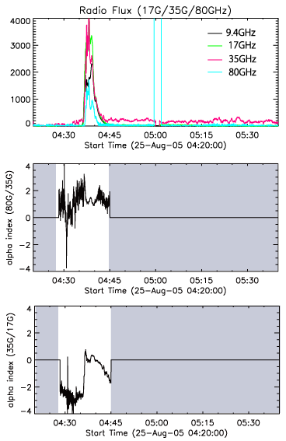
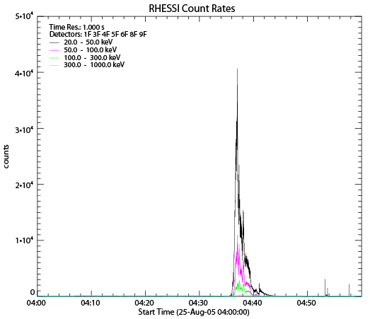
[9] 2005 Aug 25, 4:31-4:45UT M6.4 near limb event

Slide 3
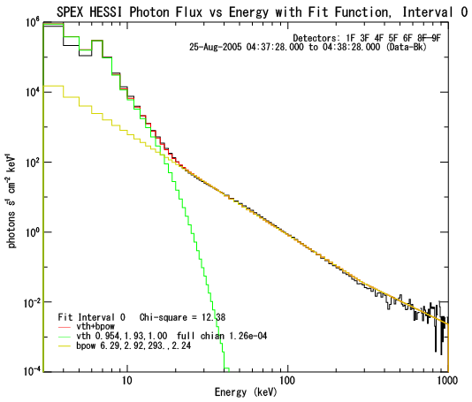
[9] 2005 Aug 25, 4:31-4:45UT M6.4 near limb event
α=1.2
E^-2.9

Slide 4
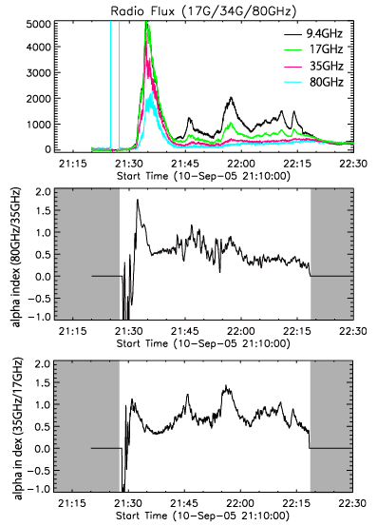
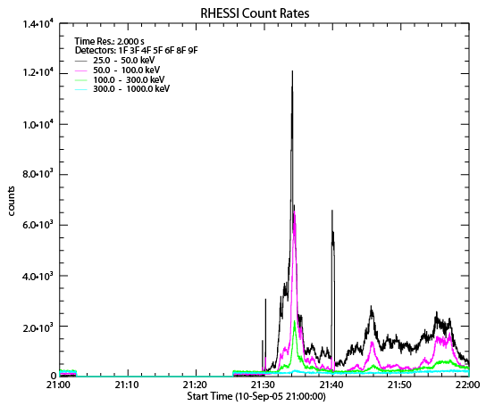
[10] 2005 Sep 10, 21:30-22:43UT X2.1 disk event

Slide 5
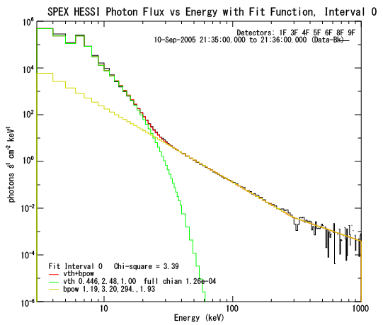
[10] 2005 Sep 10, 21:30-22:43UT X2.1 disk event (peak 1 at 21:36UT)
α=0.5
E^-3.2

Slide 6
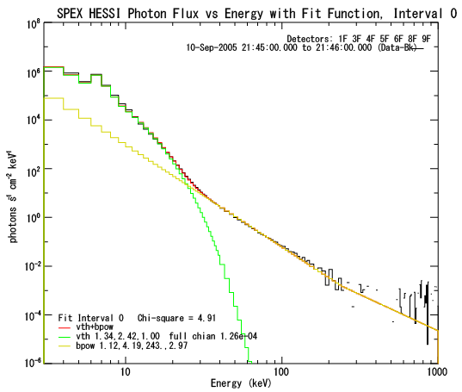
[10] 2005 Sep 10, 21:30-22:43UT X2.1 disk event (peak 2 at 21:45UT)
α=0.9
E^-4.2

Slide 7
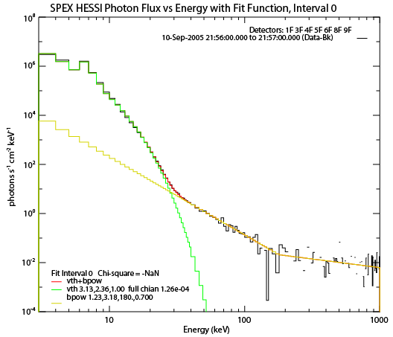
[10] 2005 Sep 10, 21:30-22:43UT X2.1 disk event (peak 3 at 21:56UT)
α=0.7
E^-3.2

Slide 8
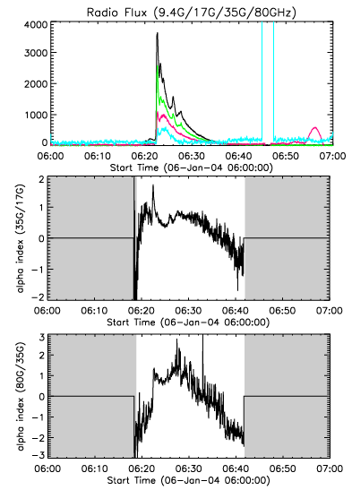
[6] 2004 Jan 6, 06:13-06:36UT M5.8 near limb event

Slide 9
[6] 2004 Jan 6, 06:13-06:36UT M5.8 near limb event
α=0.9-1.2
E^-2.9

