Slide 1
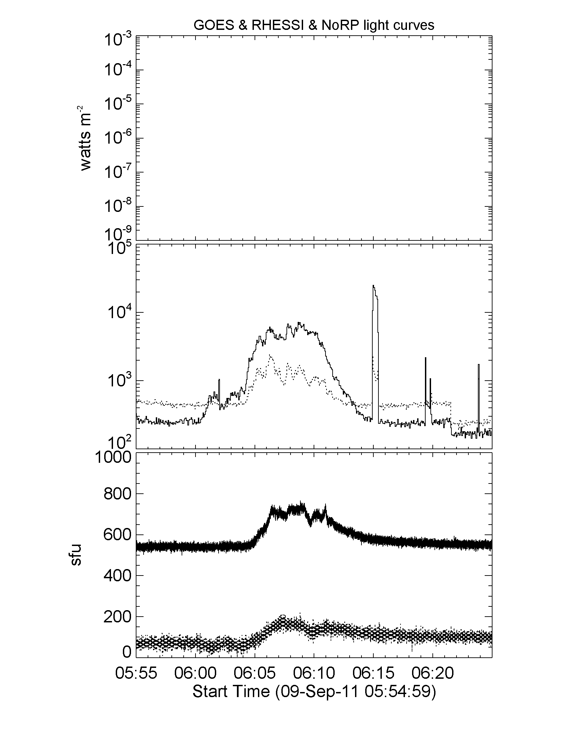
No GOES data
solid: 20-30 keV
dotted: 30-50keV
solid: 17GHz (+500sfu)
dotted: 34GHz

Slide 2
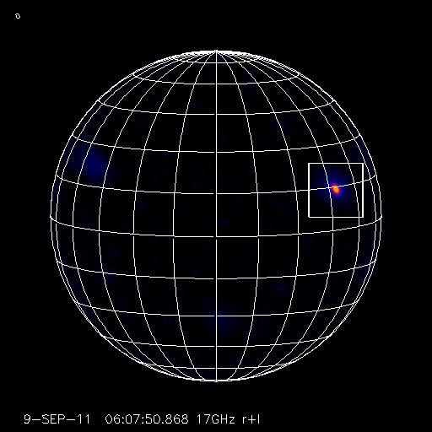

Slide 3
Color: 17GHz
Contours: 34GHz
Levels=30,50,70,90%

Slide 4
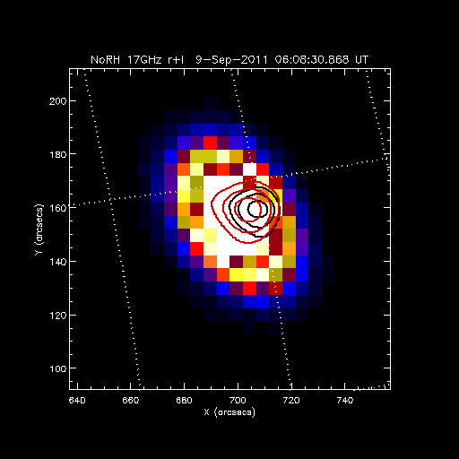
Color: 17GHz
Contours
black: 20-30keV
red: 30-50keV
Levels=50,70,90%

Slide 5
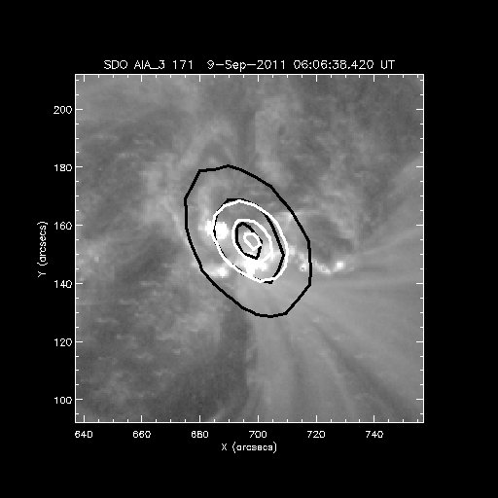
Color: AIA 171A
Contours
black: 17GHz
white: 34 GHz
levels=10,50,90%

Slide 6
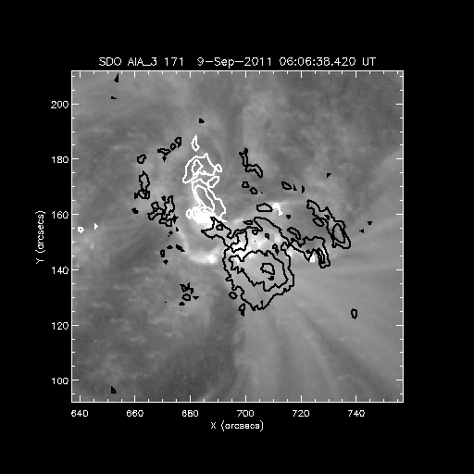
Color: AIA 171A
Contours
black: negative
white: positive
levels=±400, 800, 1200G

Slide 7
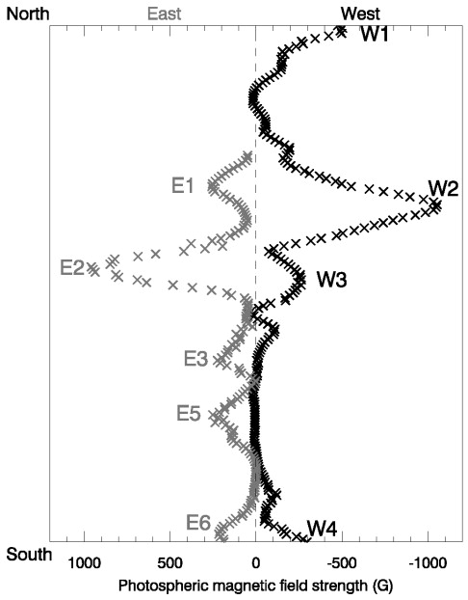
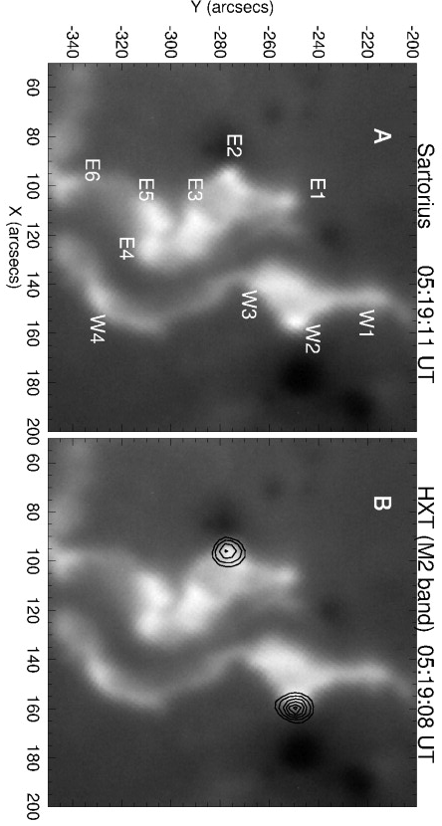
HXR
radio
Asai et al. 2002

