Slide 1
CDAW14 power index at radio regime
（は）

Slide 2
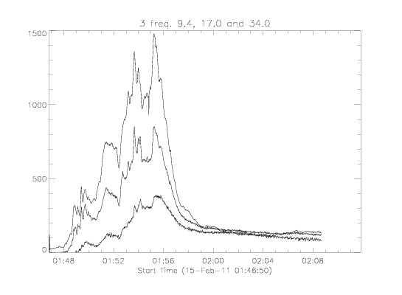
data
/share/norp/xdr/2011/02/norp20110215_0154.xdr

Slide 3
Fitting for 3 frequencies out of 7
9.4, 17.0 and 34.0 GHz
To find power-law index, delta, fitting I(f)=I0 * f^delta
By taking logarithm for frequency (GHz) and intensity (sfu), unit and other normalization factors be absorbed by linear fitting coef.
log(I’) = log(I0) + delta * log(f)
Subtracting average(s) at each frequency before taking logarithm etc.
I’ = I – Iave * (1.0 + 0.025*{-1,0,1});
Record max. & min. of linear fitting coef., a0 and a1, among 3x3x3 fittings, for error estimation.

Slide 4
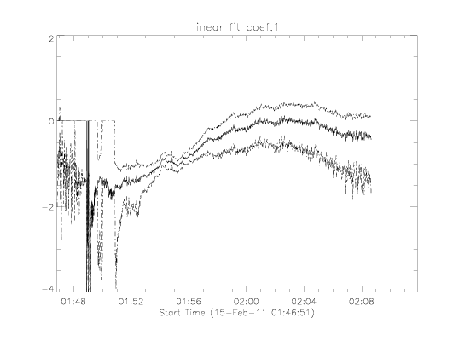
Result 1 of 2 : delta, power index
lncoef(1,*)
delta = 0
delta =-2

Slide 5
data
/share/norp/xdr/2011/02/norp20110215_0154.xdr

Slide 6
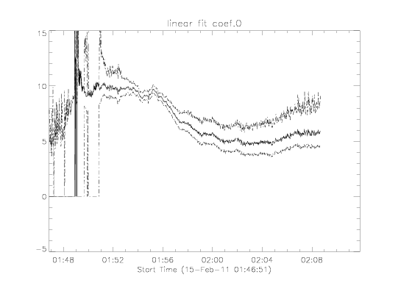
Result 2 of 2 : I0
lncoef(0,*)

Slide 7
Output data & code
/scr/web/htdocs/meeting/cdaw14/grp1/hayashi/norp_powerlaw/
nobeyama_hempa.working.pro
cdaw14_norp3_2011feb15_all.sav
fiav3.sav : logarithm of flux intensities, log(I’)
freq3.sav : logarithm of 3 frequencies, log(f)
lncoef.sav : linear fitting coefficients
timav.sav : time
*.ps *.pdf : supplemental files, omake

