Slide 1
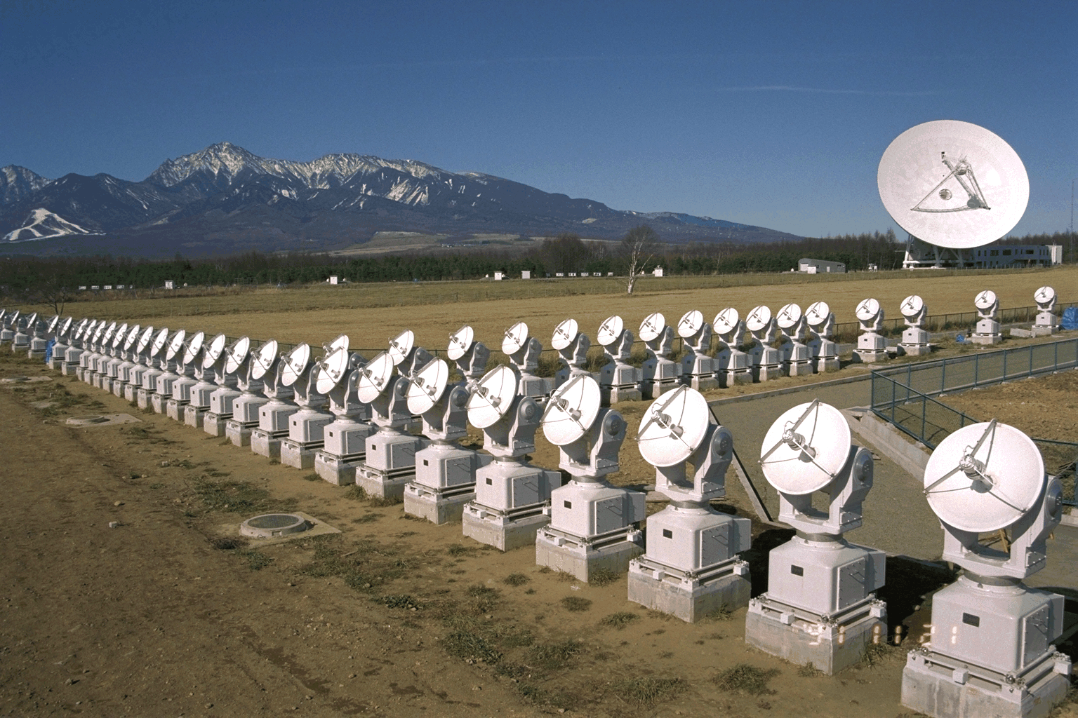
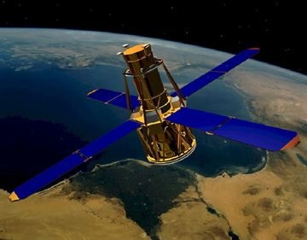
CDAW2014 group 1
NoRH-RHESSI-Hinode-SDを用いた
フレア・フィラメント放出の多波長解析
増田 智 (名古屋大学太陽地球環境研究所)

Slide 2
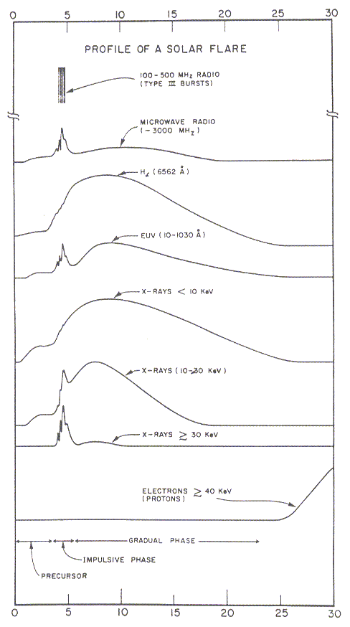
Characteristics
Increase in intensity of electromagnetic waves in various wavelengths
duration
  A few minutes – a few hours
temperature
> 10 MK
Energy
10²⁷-10³³ ergs
Occurrence
1 event/month – 10events/day
radio
Hα
UV
X-rays
electrons
← 30 min →

Slide 3
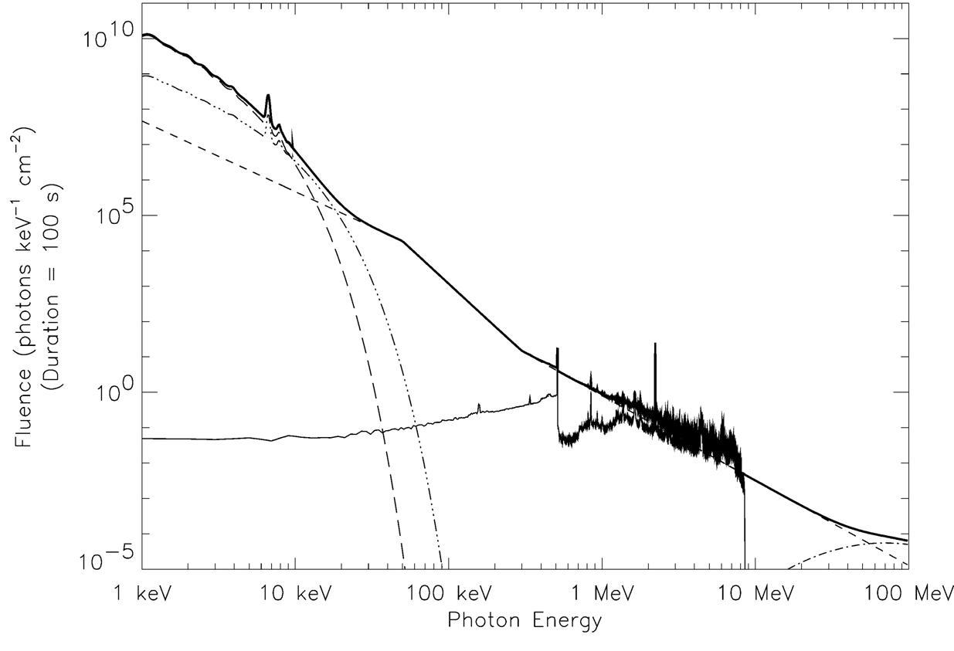
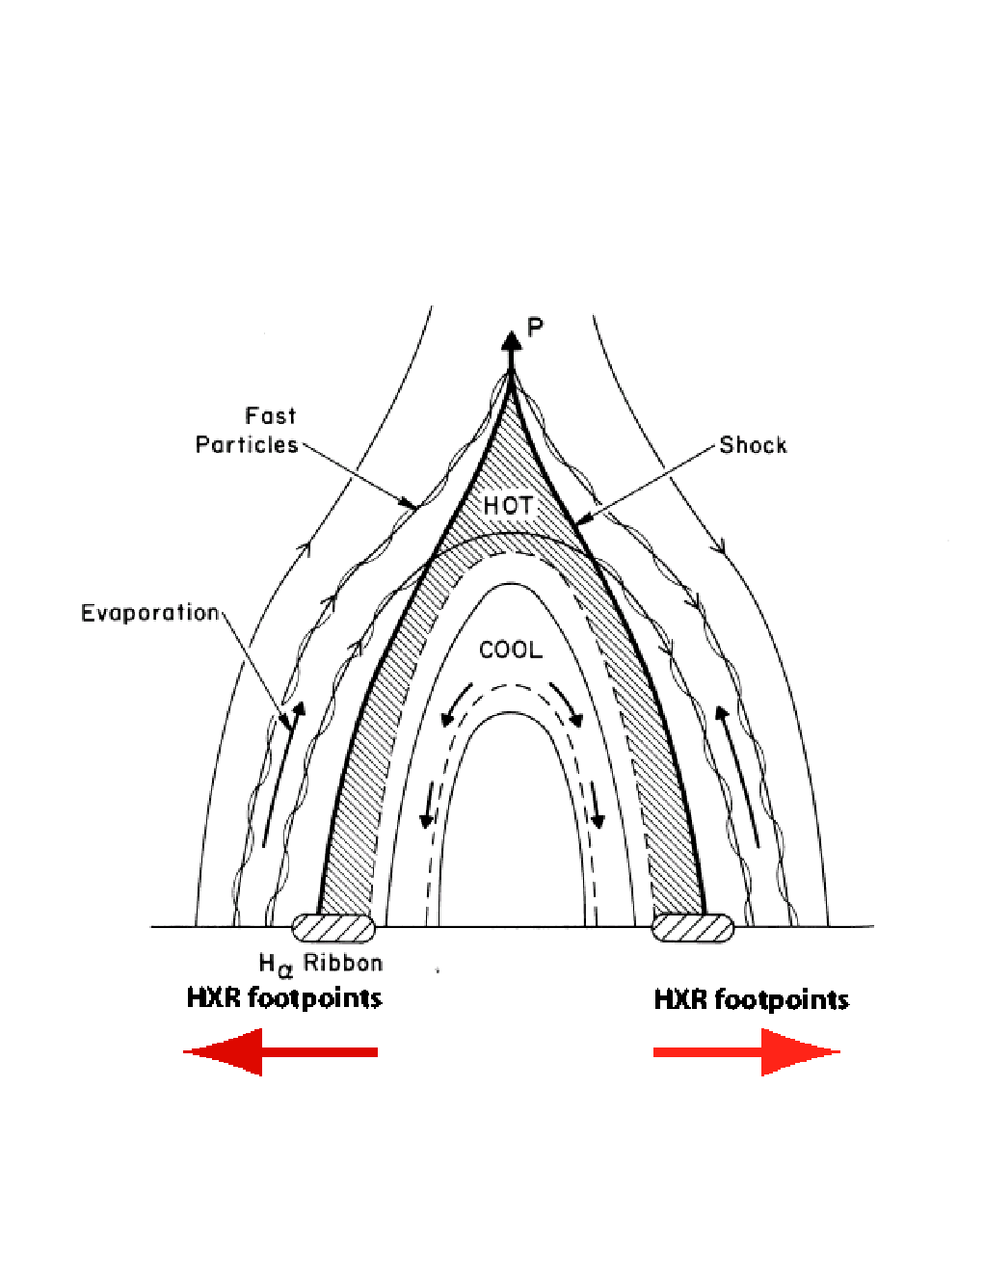
Composite Solar Flare Spectrum
Thermal Bremsstrahlung
T = 2 x 10⁷ K
T = 4 x 10⁷ K
Nonthermal Bremsstrahlung
π⁰ Decay
Positron and Nuclear
Gamma-Ray lines
SXRs
HXRs
gamma-rays

Slide 4
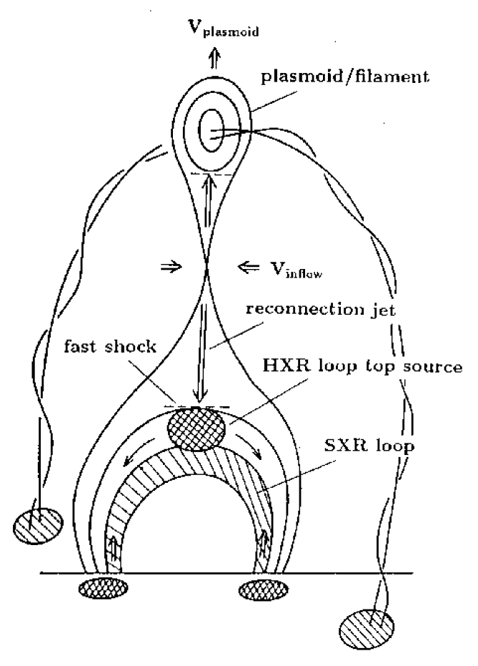
“Standard flare model”
Release of magnetic energy
magnetic
reconnection
from Shibata + Krucker

Slide 5
“Standard flare model”
Release of magnetic energy
particle are accelerated (not understood)
e⁻
magnetic
reconnection
e⁻
from Shibata + Krucker

Slide 6
“Standard flare model”
Release of magnetic energy
particle are accelerated (not understood)
Acc. electrons produce HXR emission (mostly footpoints)
e⁻
magnetic
reconnection
e⁻
HXR footpoints
from Shibata + Krucker

Slide 7
“Standard flare model”
Release of magnetic energy
particle are accelerated (not understood)
Acc. electrons produce HXR emission (mostly footpoints)
Above loop top HXR source not understood
e⁻
magnetic
reconnection
e⁻
?
HXR footpoints
from Shibata + Krucker

Slide 8
“Standard flare model”
Release of magnetic energy
particle are accelerated (not understood)
Acc. electrons produce HXR emission (mostly footpoints)
Above loop top HXR source not understood
collisional loses of acc. electrons heat plasma
“evaporation” fills loop
e⁻
magnetic
reconnection
e⁻
?
evaporation
HXR footpoints
from Shibata + Krucker

Slide 9
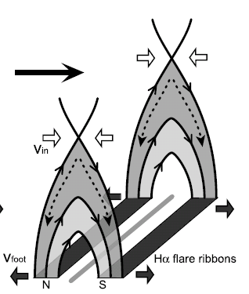
Relationships between electric field and particle acceleration
E_{rec}=-v×B is estimated from observations.
Asai et al. (2004)
v: ribbon expansion
B: photospheric
magnetic field
Flare ribbon
(or footpoint HXR source)
= frontline of continuous reconnection in the corona
v

Slide 10
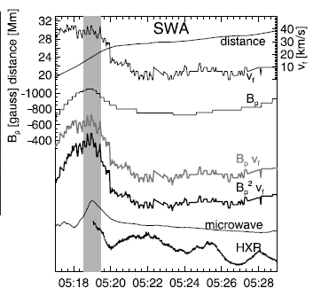
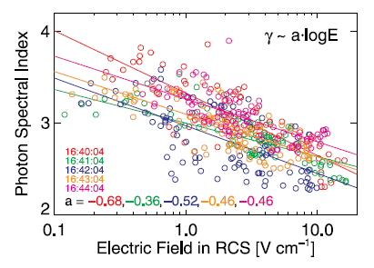
Relationships between electric field and particle acceleration
Electric field vs HXR intensity
Electric field vs HXR spectral index
E
(Asai et al. 2004)
(Liu et al. 2008)
HXR/microwave peak

Slide 11
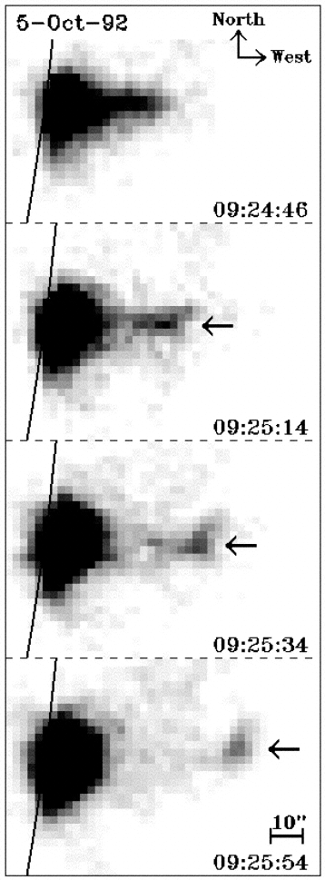
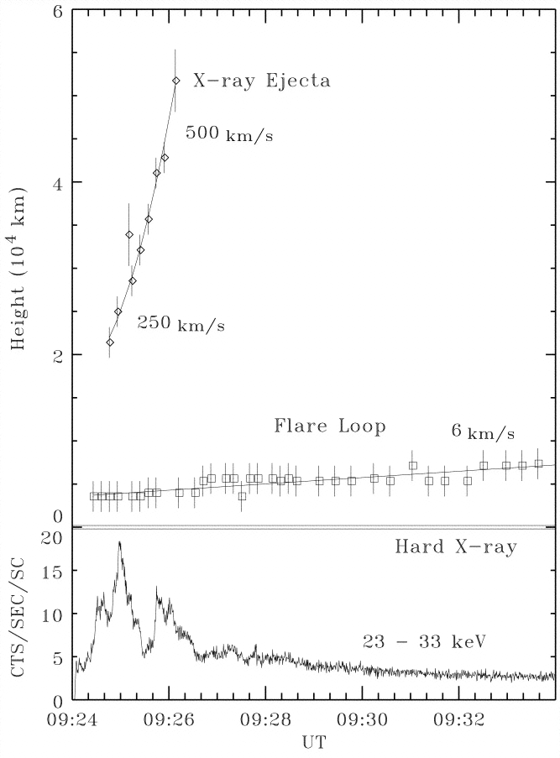
プラズマ放出現象と粒子加速(硬X線)
Ohyama and Shibata (1998)

Slide 12
Purpose
To understand the relationship between particle acceleration and magnetic reconnection in solar flares.
Data Analyses
STEP 1
Electric field ← Hard X-ray source motion, photoshperic magnetic field
Ca II ribbon motion, photospheric magnetic field
STEP 2
Hard X-ray intensity, spectrum (power-law lindex) vs electric field
Microwave intensity, spectrum (power-law index) vs electric field
Eruption (SDO, STEREO) vs electric field

Slide 13
Hard X-rays 硬X線
radiation mechanism 放射機構
Bremsstrahlung 制動放射 ( or free-free emission)
same as soft X-rays
but by nonthermal electrons
or by super-hot (>30MK) plasma
Hard X-rays are detected only during a solar flare.
The solar corona is usually very dark in hard X-rays.

Slide 14
Electric field vs HXR spectral index
Only in this event, the relationship between hard X-ray spectral index and electric field was reported.
We must check if this relationship is valid or not in other events.
(Liu et al. 2008)

Slide 15
Event selection
Criteria
Reported in the NoRH event list
Simultaneous observations with RHESSI
and RHESSI detected > 50 keV photons
(3) SDO data are available
(4) Occurred near the disk center (East 30 deg. to West 30 deg.)
(5) Hinode/SOT data are available
The selected events
20110215_0154 X2.2 S20W10
20120705_0337 M4.7 S18W29
20130502_0504 M1.1 N10W26

Slide 17
Hard X-ray Observations in solar flares

Slide 18
Composite Solar Flare Spectrum
Thermal Bremsstrahlung
T = 2 x 10⁷ K
T = 4 x 10⁷ K
Nonthermal Bremsstrahlung
π⁰ Decay
Positron and Nuclear
Gamma-Ray lines
Soft X-ray
Hard X-ray
Gamma-ray

Slide 19
2.4.2 hard X-ray telescope 硬X線望遠鏡
It is very hard to reflect hard X-rays with a mirror optics.
modulation-collimator type telescope (すだれコリメータ)
proposed by Dr. Minoru Oda (小田 稔)
Characteristics of hard X-rays:
high transmission, low diffraction
(高い透過性、低い回折性 = 高い直進性)
Hinotori/SXT (1981 – 1982) rotating bigrid
Yohkoh/HXT (1991 – 2001) multi-element bigrid
RHESSI (2002 – present) rotating multi-element bigrid

Slide 20
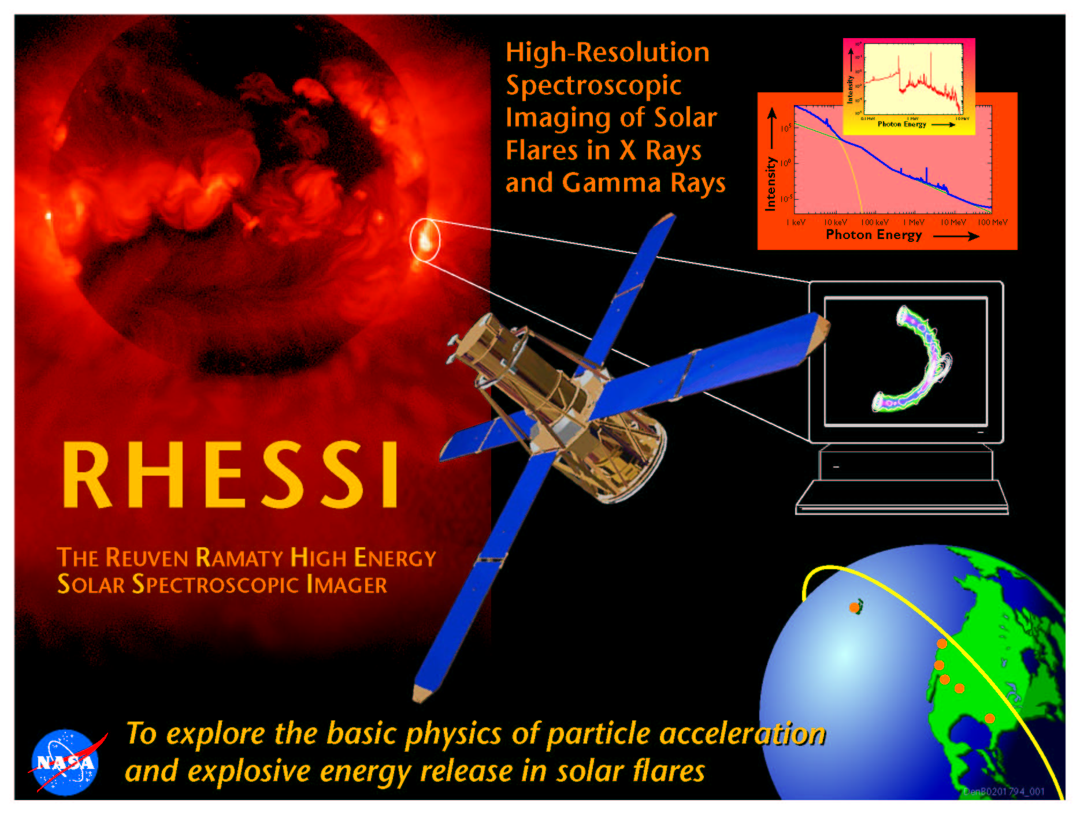
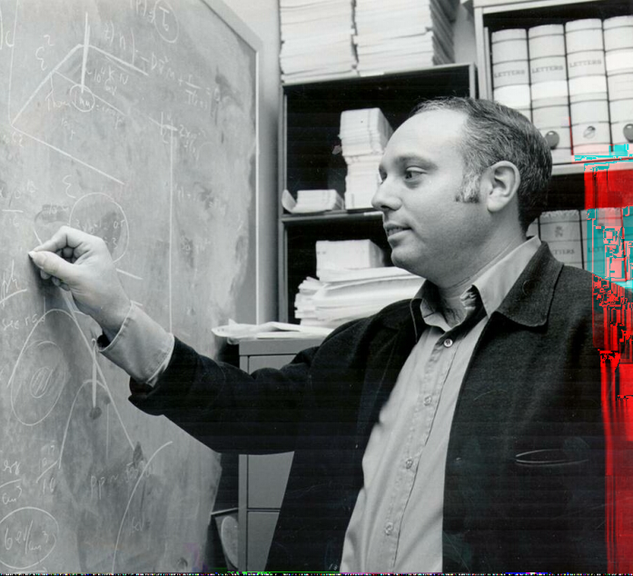
.
.
Reuven Ramaty
1937 – 2001

Slide 21
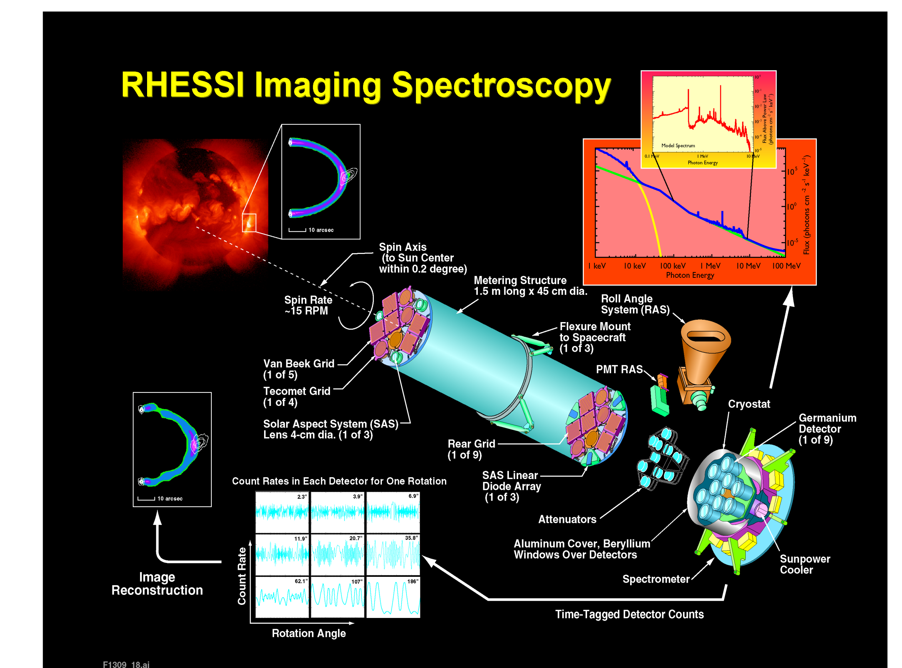
Instrument overview
Germanium
detectors

Slide 22
Instrument overview
grids (masks)
spinning
spacecraft

Slide 23
Instrument overview
grids (masks)
Modulated
signal
image information
is stored in modulations

Slide 24
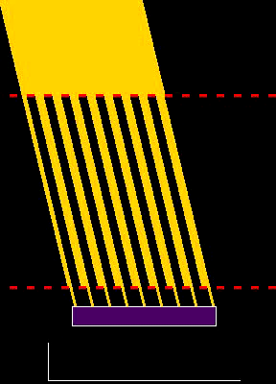
RHESSI imaging
incoming X-rays
grid
grid
detector
detected signal is modulated

Slide 25
Spatial distribution of hard X-ray sources (硬X線源の分布)
0 | 0 | 1 | 3 | 0 | 0
0 | 1 | 2 | 5 | 2 | 1
0 | 0 | 0 | 2 | 0 | 0
0 | 0 | 0 | 0 | 0 | 0
0 | 5 | 0 | 0 | 0 | 0
0 | 0 | 0 | 0 | 0 | 0
0 | 0 | 1 | 3 | 0 | 0
0 | 1 | 2 | 5 | 2 | 1
0 | 0 | 0 | 2 | 0 | 0
0 | 0 | 0 | 0 | 0 | 0
0 | 5 | 0 | 0 | 0 | 0
0 | 0 | 0 | 0 | 0 | 0
0 | 0 | 1 | 3 | 0 | 0
0 | 1 | 2 | 5 | 2 | 1
0 | 0 | 0 | 2 | 0 | 0
0 | 0 | 0 | 0 | 0 | 0
0 | 5 | 0 | 0 | 0 | 0
0 | 0 | 0 | 0 | 0 | 0
0 | 0 | 1 | 3 | 0 | 0
0 | 1 | 2 | 5 | 2 | 1
0 | 0 | 0 | 2 | 0 | 0
0 | 0 | 0 | 0 | 0 | 0
0 | 5 | 0 | 0 | 0 | 0
0 | 0 | 0 | 0 | 0 | 0

Slide 26
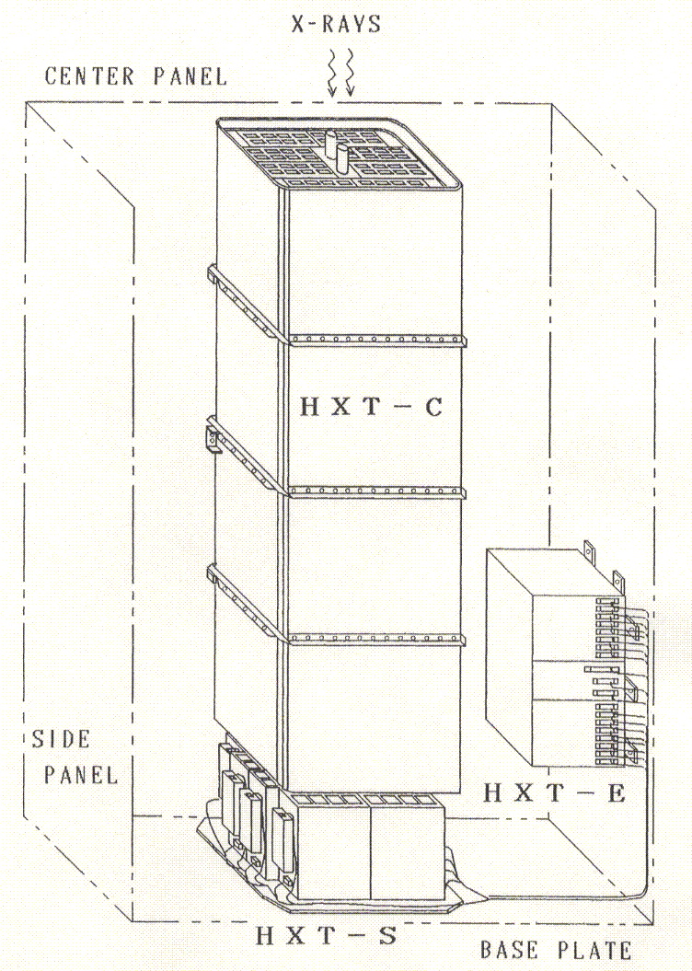
Yohkoh
Hard X-ray Telescope

Slide 27
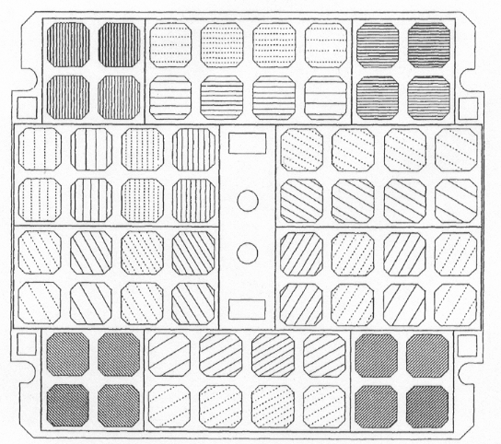
Yohkoh/HXT: concept of modulation collimators

Slide 28
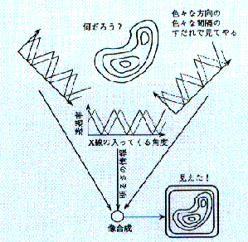
Image synthesis by modulation collimators
すだれコリメータによる像合成の概念図

Slide 29
HXT
Composite Solar Flare Spectrum
Thermal Bremsstrahlung
T = 2 x 10⁷ K
T = 4 x 10⁷ K
RHESSI
Nonthermal Bremsstrahlung
π⁰ Decay
Positron and Nuclear
Gamma-Ray lines
Soft X-ray
Hard X-ray
Gamma-ray

Slide 30
Yohkoh/HXT vs RHESSI
 | Yohkoh/HXT | RHESSI
Effective area | ~60cm² (64 detectors) | ~100cm² (9 detectors)
Energy range | 14-93 keV | 3 keV – 15 MeV
Energy resolution | 2 keV at 10 keV 10 keV at 100 keV | < 1 keV at 3 keV 5 keV at 15 MeV
Field of view | full sun | full sun
Spatial resolution | ~5 arcsec | 2 arcsec < 100 keV 7 arcsec < 400 keV 36 arcsec > 400 keV
Time resolution | 0.5 sec | 2 sec
Dynamic range | ~10:1 | 50:1– 100:1

Slide 31
SPECTROSCOPY
Composite Solar Flare Spectrum
hot loop
Thermal Bremsstrahlung
T~10-40 MK
HXR
footpoint
photosphere
Nonthermal Bremsstrahlung
Spectral observations:
non-themal emission >10 keV
thermal emission below
Quantitative measurements
π⁰ Decay
soft X-rays hard X-rays
g-rays →

Slide 32
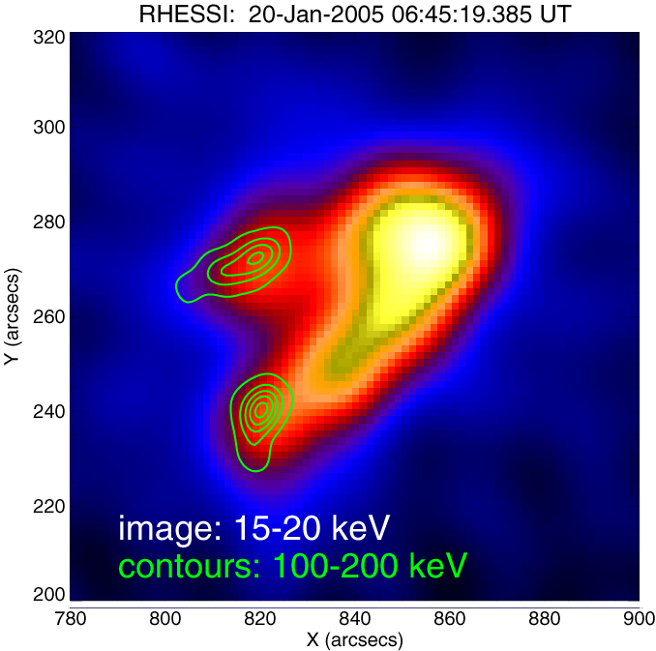
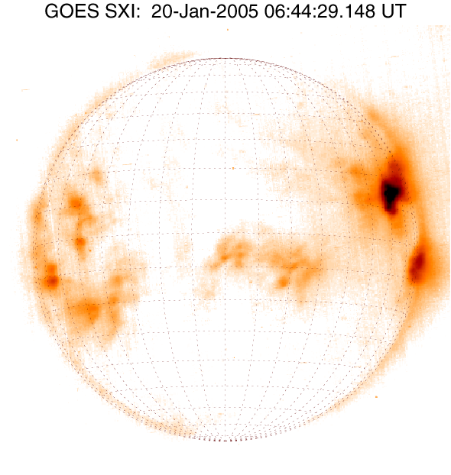
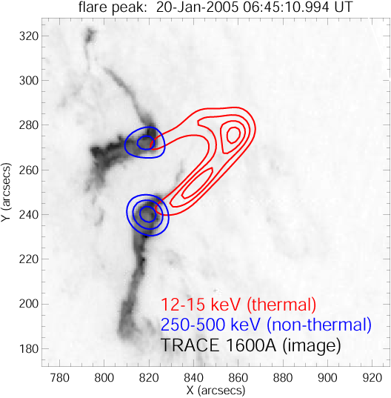
X-ray imaging
Example:
very large flare occurring near solar limb (side view)
Two ribbon flare with 2 HXR footpoints (blue) and thermal loop (red)

Slide 33
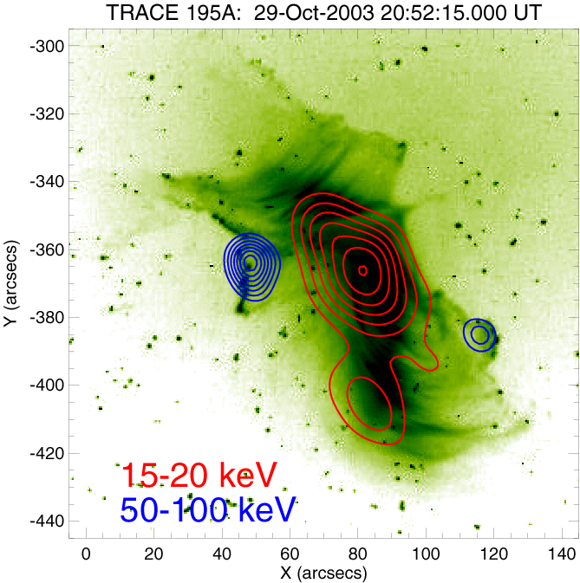
flare near solar disk center (view from above)
IMAGE:
TRACE EUV emission ~1.5MK
blue contours:
HXR footpoints
(non-thermal
Bremsstrahlung)
red contours:
thermal X-ray emission

Slide 34
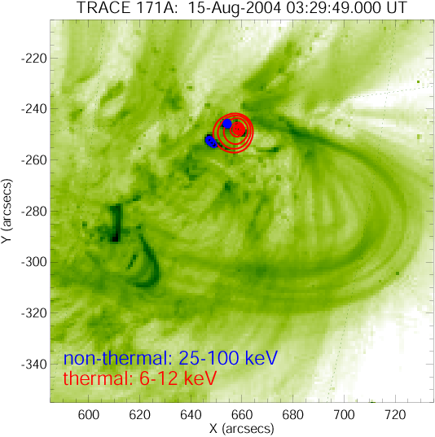
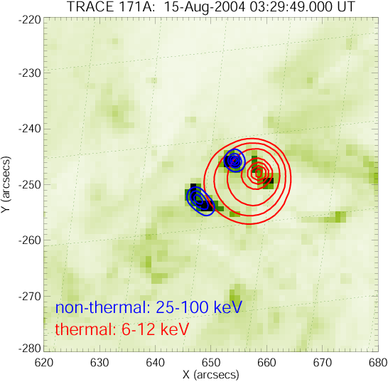
Very compact flare
7000 km
2” (1500 km) spatial resolution

