Slide 1
Result List
CDAW14 Group2
Shun Miyawaki

Slide 2
Event
2011/12/25 00:05:00 (UT)
NOAA AR 11384
2012/06/15 00:11:00 (UT)
NOAA AR 11504
2012/06/16 00:11:00 (UT)
NOAA AR 11504
2012/06/16 05:31:00 (UT)
NOAA AR 11504

Slide 3
(A) 2011/12/25 00:05:00 (UT) NOAA AR 11384

Slide 4
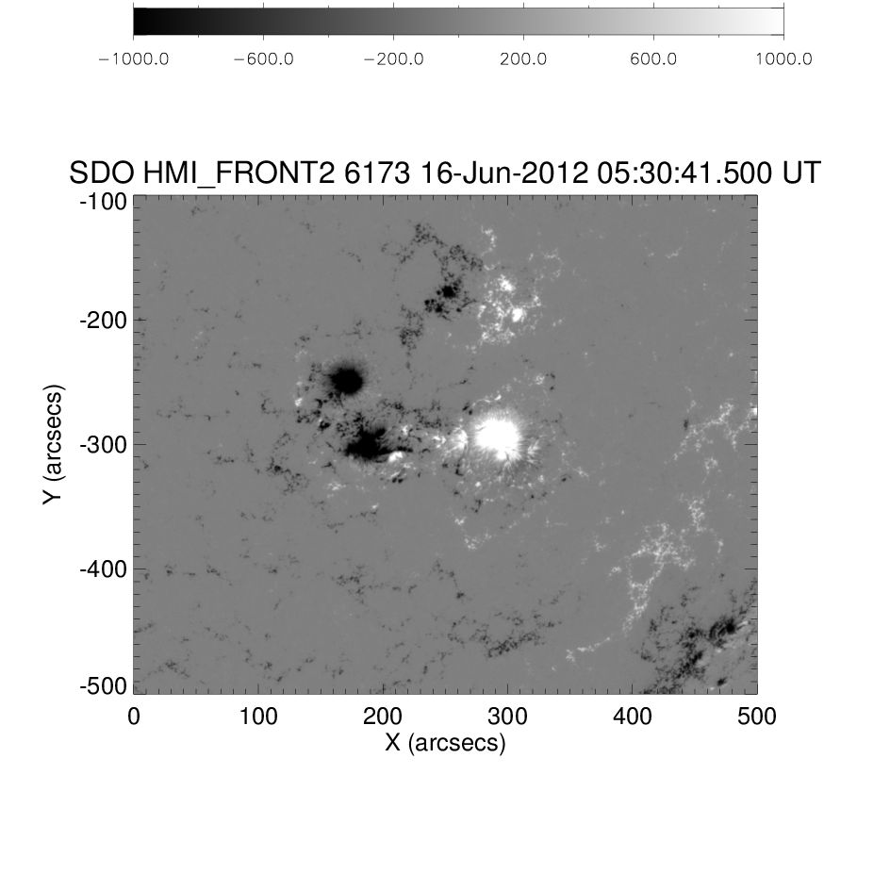
SDO/HMI LOS Magnetic Field

Slide 5
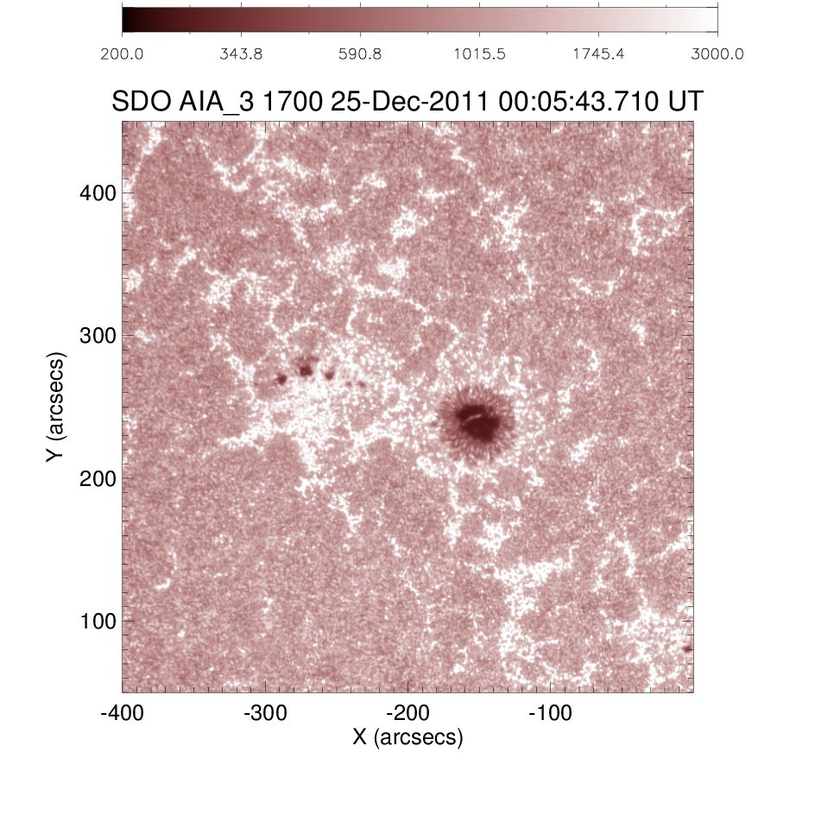
SDO/AIA 1700Å

Slide 6
SDO/AIA 1700Å vs NoRH 34GHz
SDO/AIA 1700Å
10000K
9500K
9000K
8500K

Slide 7
NoRH 34GHz

Slide 8
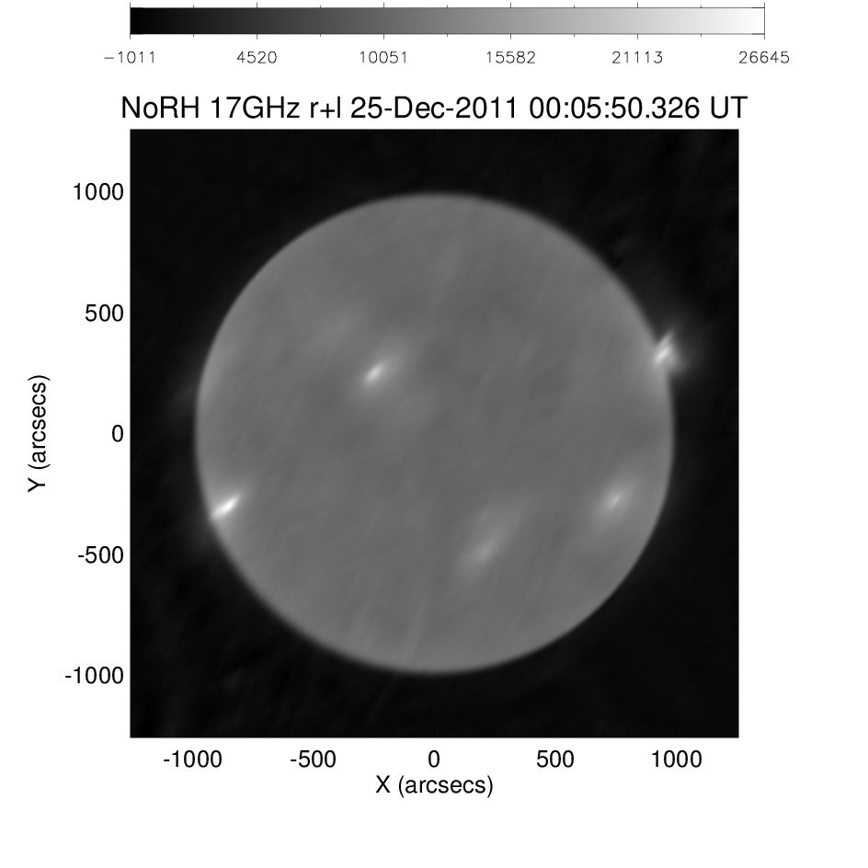
NoRH 17GHz LCP
NoRH 17GHz RCP

Slide 9
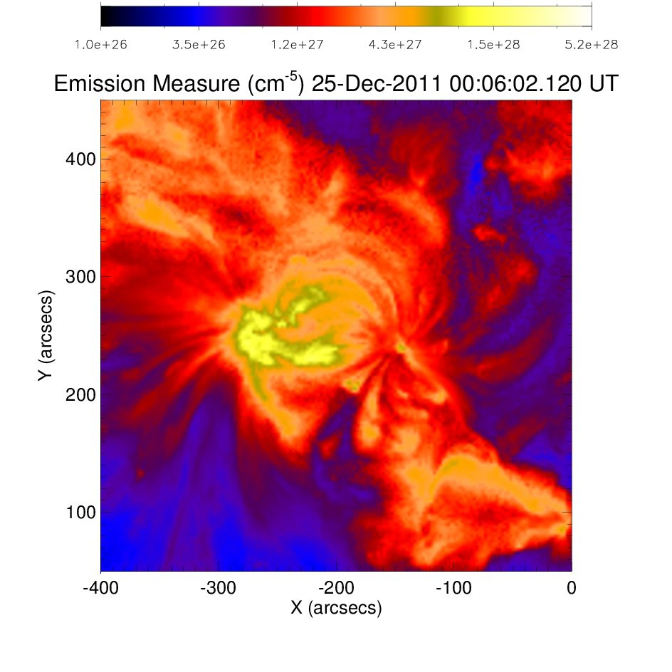
AIA Emission Measure

Slide 10
AIA 1700Å vs 17GHz LCP
AIA Emission Measure
20000K
15000K
10000K
9500K

Slide 11
(B) 2012/06/15 00:11:00 (UT) NOAA AR 11504

Slide 12
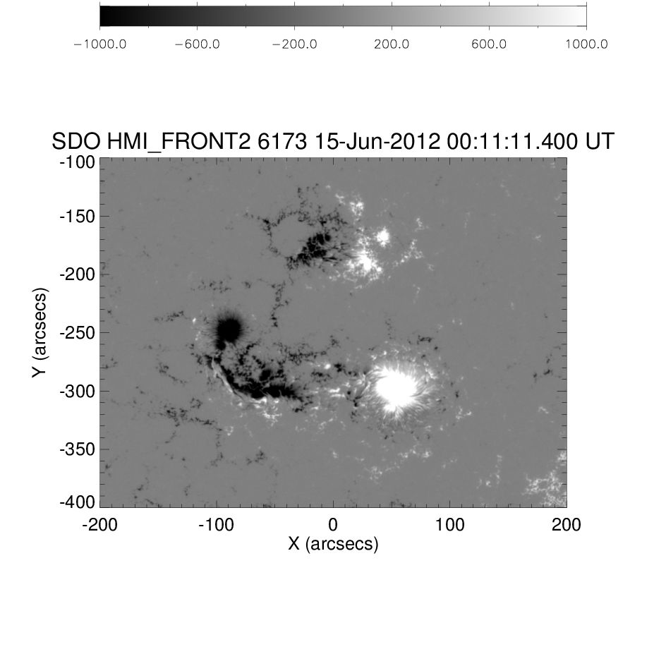
SDO/HMI LOS Magnetic Field

Slide 13
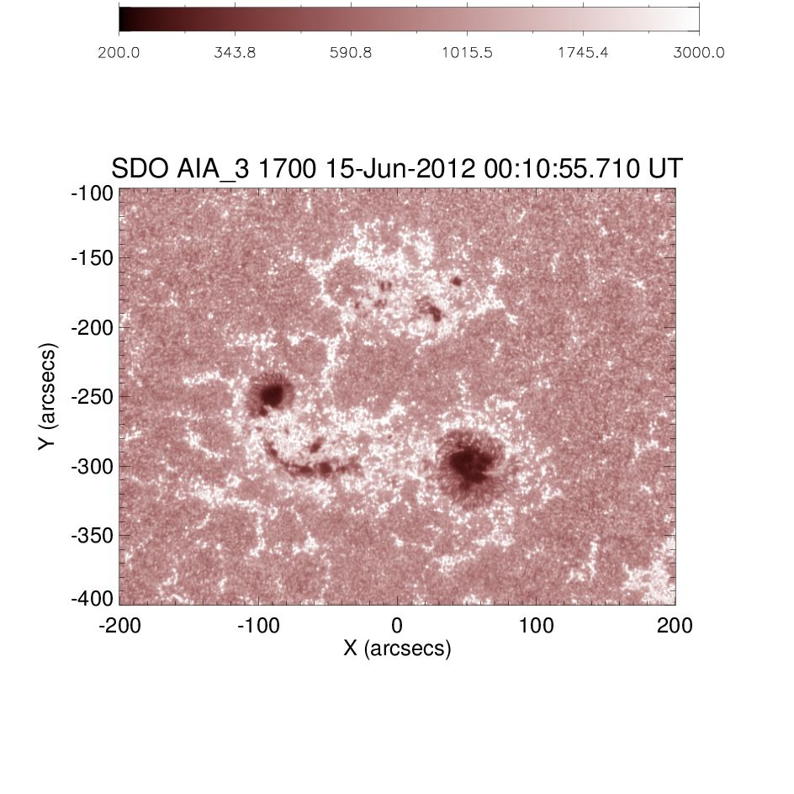
SDO/AIA 1700Å

Slide 14
SDO/AIA 1700Å vs NoRH 34GHz
SDO/AIA 1700Å
10000K
9500K
9000K
8500K

Slide 15
NoRH 34GHz

Slide 16
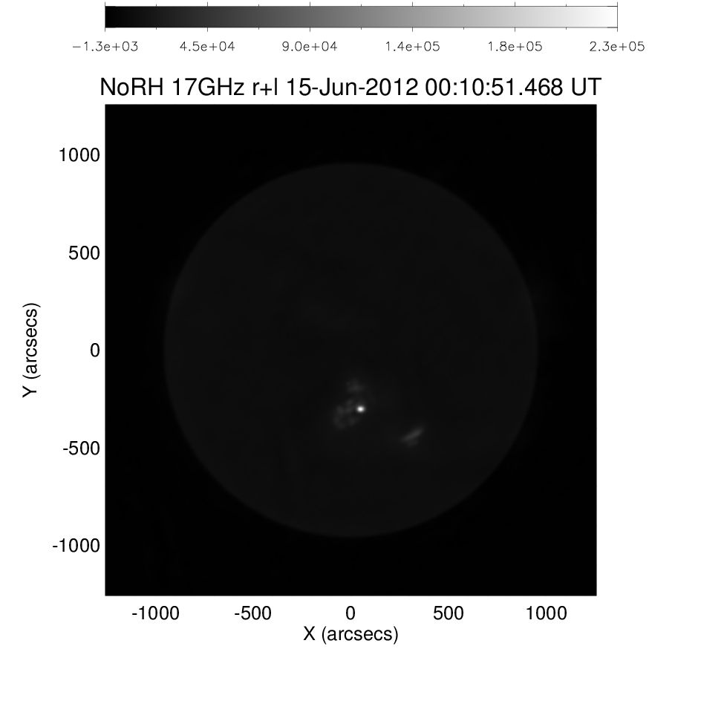
NoRH 17GHz LCP
NoRH 17GHz RCP

Slide 17
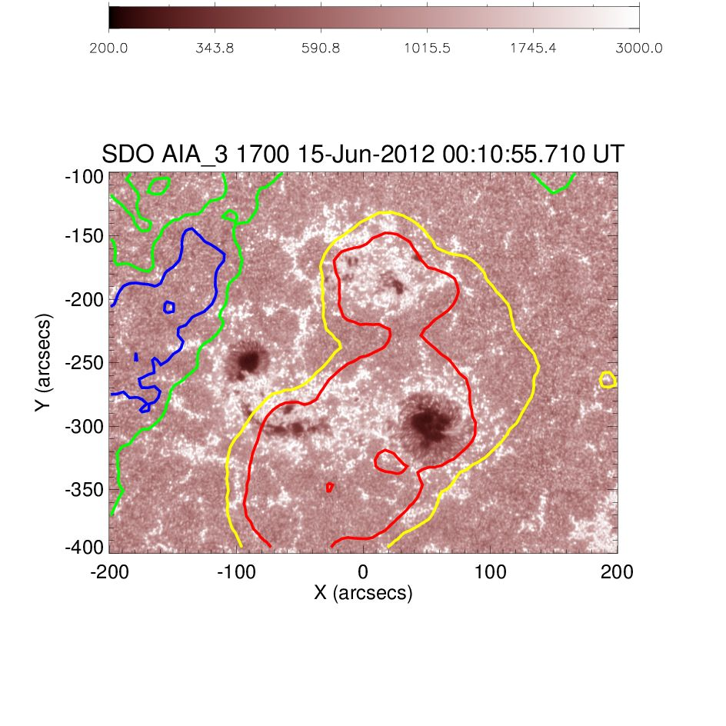
AIA 1700Å vs 17GHz LCP
AIA 1700Å vs 17GHz RCP
20000K
15000K
10000K
9500K

Slide 18
(C) 2012/06/16 00:11:00 (UT) NOAA AR 11504

Slide 19
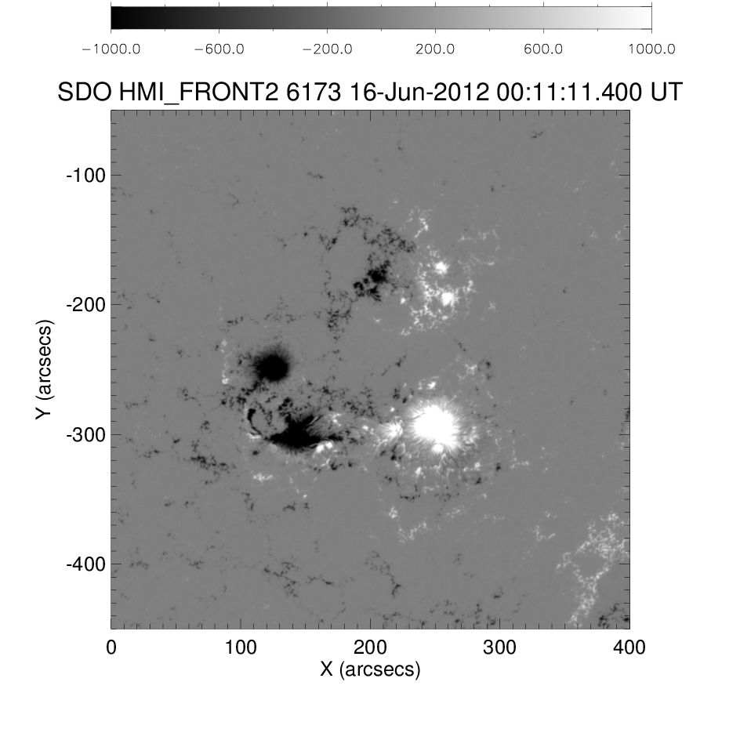
SDO/HMI LOS Magnetic Field

Slide 20
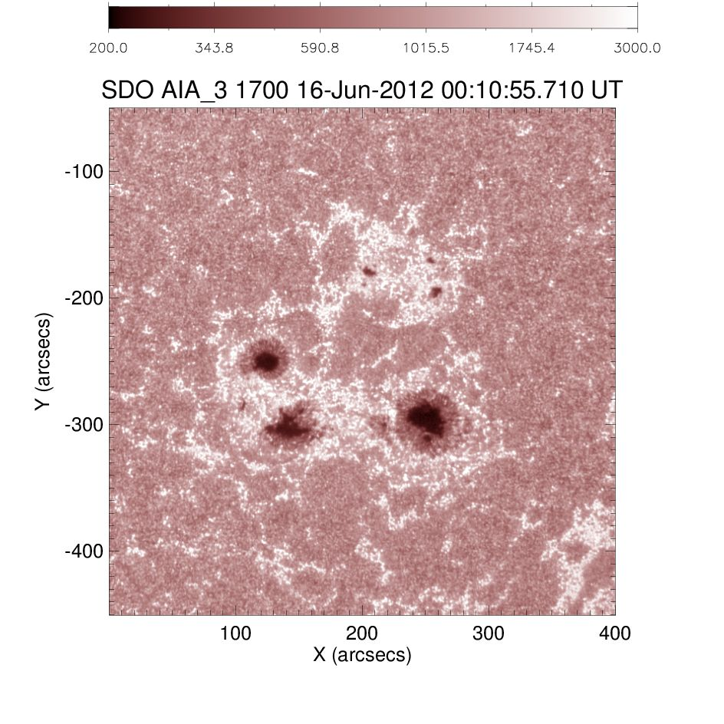
SDO/AIA 1700Å

Slide 21
SDO/AIA 1700Å vs NoRH 34GHz
SDO/AIA 1700Å
10000K
9500K
9000K
8500K

Slide 22
NoRH 34GHz

Slide 23
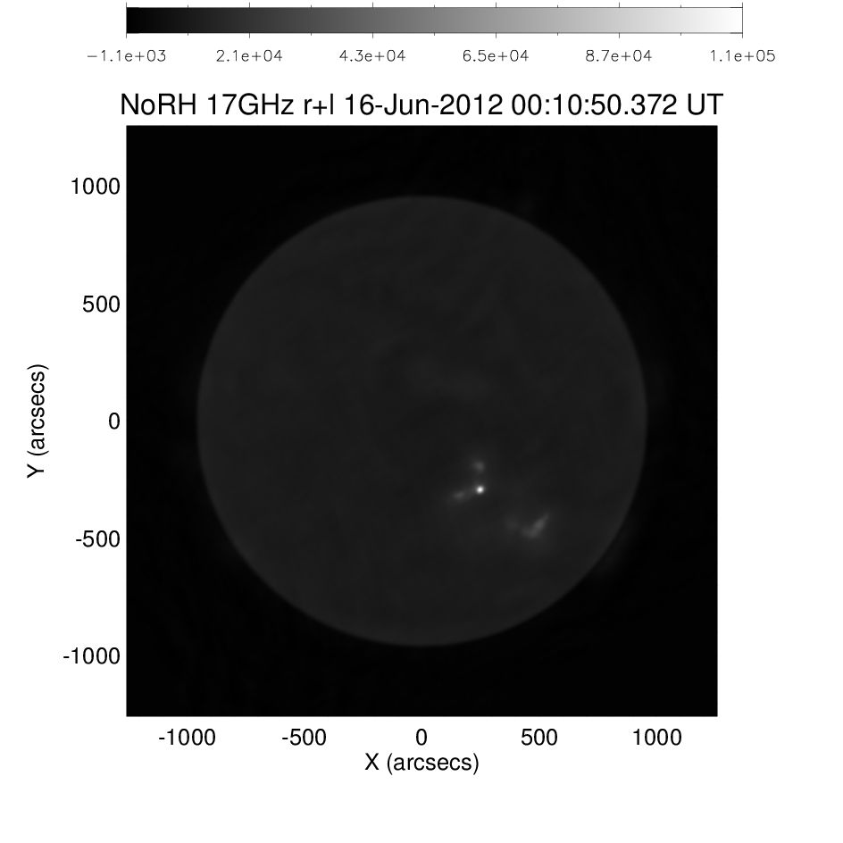
NoRH 17GHz LCP
NoRH 17GHz RCP

Slide 24
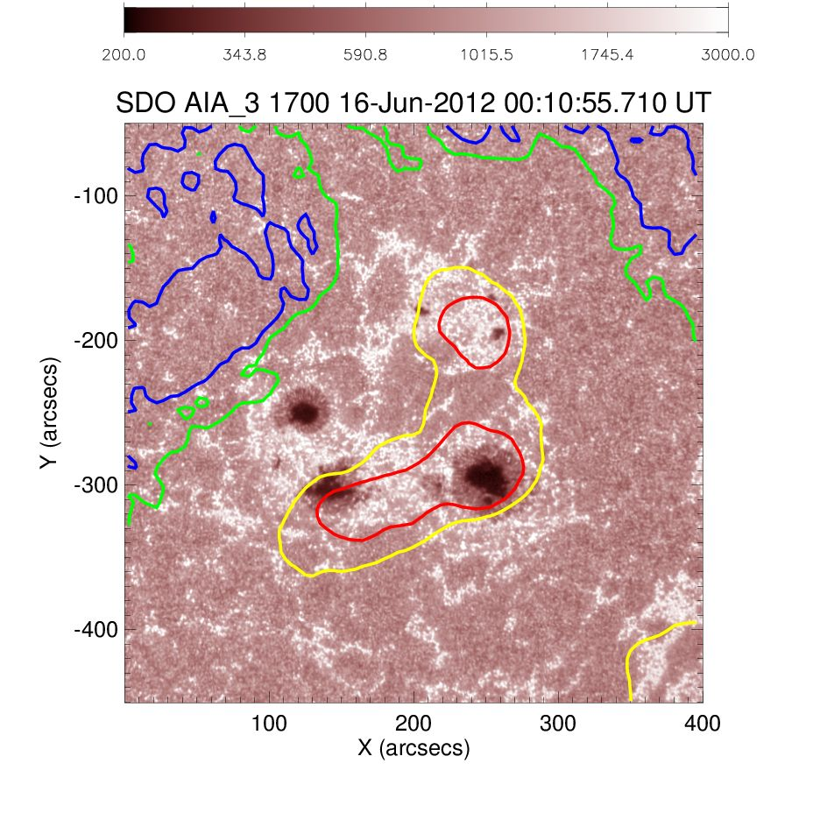
AIA 1700Å vs 17GHz LCP
AIA 1700Å vs 17GHz RCP
20000K
15000K
10000K
9500K

Slide 25
(A) 2012/06/16 05:30:00 (UT) NOAA AR 11504

Slide 26
SDO/HMI LOS Magnetic Field

Slide 27
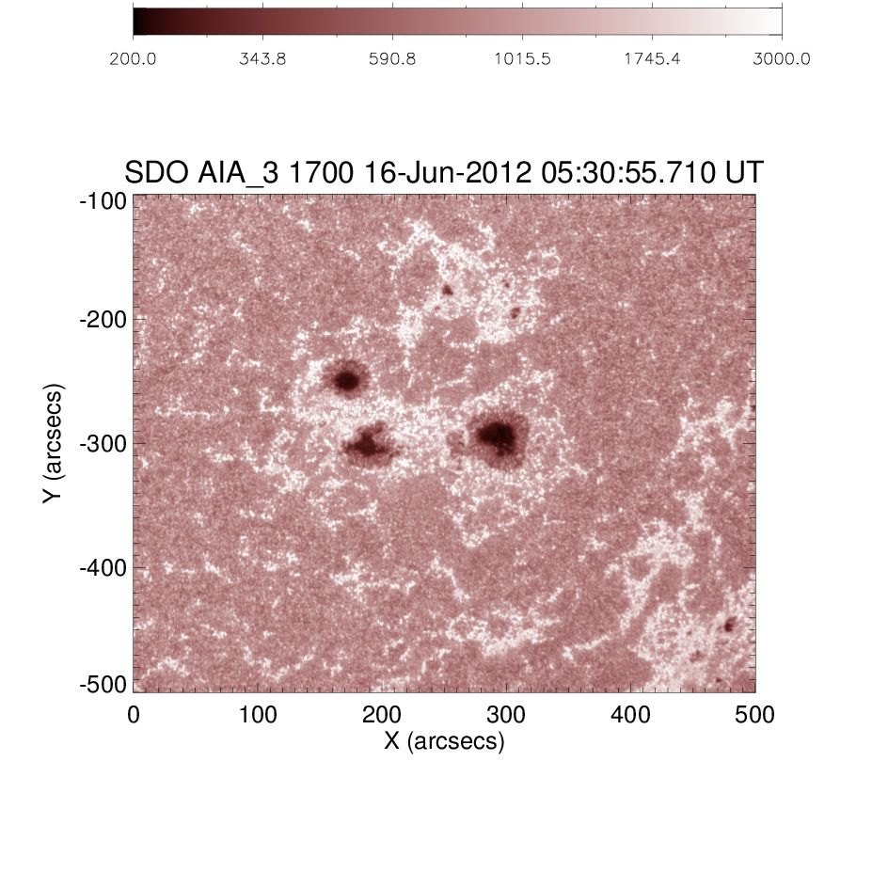
SDO/AIA 1700Å

Slide 28
SDO/AIA 1700Å vs NoRH 34GHz
SDO/AIA 1700Å
10000K
9500K
9000K
8500K

Slide 29
NoRH 34GHz

Slide 30
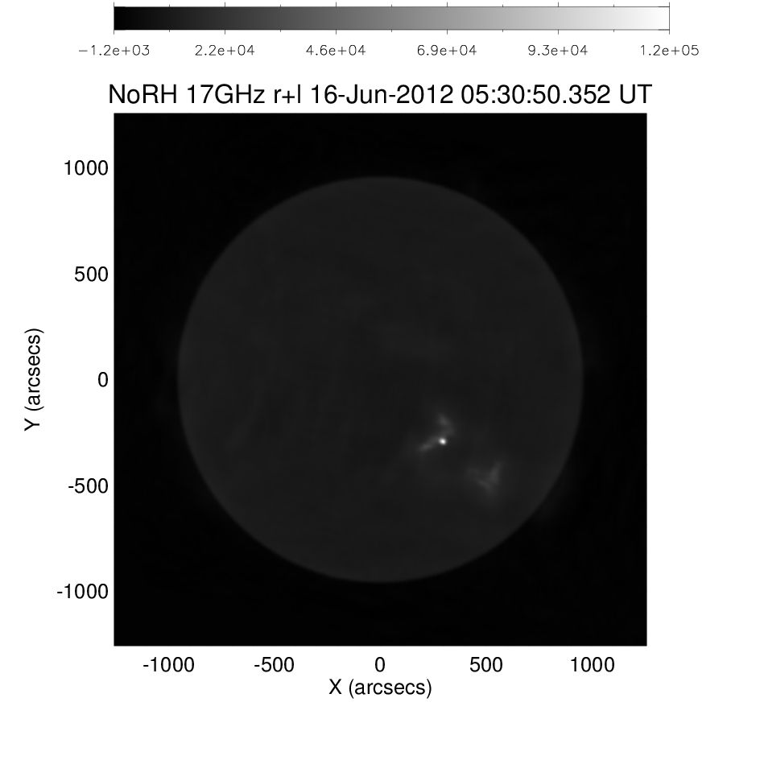
NoRH 17GHz LCP
NoRH 17GHz RCP

Slide 31
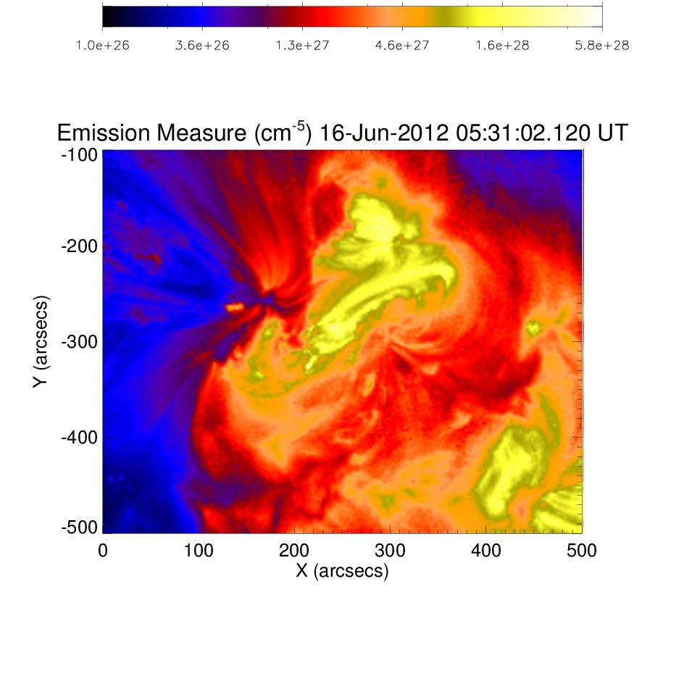
AIA Emission Measure

Slide 32
AIA 1700Å vs 17GHz LCP
AIA Emission Measure
20000K
15000K
10000K
9500K

